Slide 1
Enhancing formative assessment through digital technology
Diane Dalby
University of Nottingham
BERA September 2016

Slide 2
The Fasmed project
An EU project involving 9 partners in 8 different countries:
University of Newcastle, UK
University of Nottingham, UK
Ecole Normale Superieure de Lyon, France
National University of Ireland, Maynooth, Republic of Ireland
University of Education, Freiburg, Germany
University of Turin, Italy
Freudenthal Institute, Holland
African Institute for Mathematical Sciences, Capetown, South Africa
Sor-Trondelag University College, Norway

Slide 3
Project aims
The Fasmed (Formative Assessment in Science and Mathematics Education) project aims to:
foster high quality interactions in international classrooms that are instrumental in raising achievement for low achievers;
expand our knowledge of technologically enhanced teaching and assessment methods addressing low achievement in mathematics and science.

Slide 4
The Fasmed project at Nottingham
The research focuses on the use of iPads in mathematics lessons and how they can be used to facilitate or enhance formative assessment.
The lessons designed and observed in this phase all involved some use iPads (or laptops) but with different software and mathematical topics.

Slide 5
Formative assessment
“Practice in a classroom is formative to the extent that evidence about student achievement is elicited, interpreted and used by teachers, learners, or their peers, to make decisions about the next steps in instruction that are likely to be better, or better founded, than the decisions they would have taken in the absence of the evidence that was elicited.”
(Black & Wiliam, 2009)

Slide 6
Formative assessment
(adaptive teaching)
Students and teachers;
Using evidence of learning;
To adapt teaching and learning;
To meet immediate student needs;
Minute-to-minute and day-by-day.
(Thompson and Wiliam, 2007)

Slide 7
Research questions
How do teachers obtain, process and present formative assessment data from students using digital technology?
How do teachers inform and adapt their future teaching using such data?

Slide 8
 | Where the learner is going | Where the learner is right now | How to get there
Teacher | A. Clarifying learning intentions and criteria for success | B. Engineering effective classroom discussions and other learning tasks that elicit evidence of student understanding | C. Providing feedback that moves learners forward
Peer | D. Understanding (shared) learning intentions and criteria for success | E. Activating students as instructional resources for one another
Learner | D. Understanding learning intentions and criteria for success | E. Activating students as the owners of their own learning

Slide 9
Technology
A cultural revolution that affects our social lives and has the potential to transform education. (Vander Ark, 2011)
Consistent evidence of positive benefits but difficult to identify specific implications for professional practice because of the wide variety of technologies and contexts.
(Higgins et al., 2012)
The research knowledge base regarding the impact on learning from tablets is still fragmented, making it difficult to draw firm conclusions. (Hassler, Major and Hennessey, 2015)

Slide 10
Technology and pedagogy
Three strands that are interlinked but are unequally developed:
Technology
Pedagogy
System change
(Fullan and Donnelly, 2013)

Slide 11
Research approach
A design research approach to the development of lessons that incorporated the use of iPads in different ways into formative assessment;
Three schools with three teachers in each working in partnership with the UoN team to design and trial three different lessons in each school;
Cycles of design, implementation, feedback and revision allowing different approaches to be explored with each lesson.

Slide 12
Lesson design and review
A cycle of lesson planning involving collaboration, observation, reflection and feedback into the next lesson.
Collaborative planning
Observation
Reflection
Feedback
Implementation

Slide 13
Lesson 1: distance-time graphs
Two diagnostic questions to start the lesson;
Use of Showbie to send, receive and display selected student responses;
Selected student work used to discuss and address misconceptions;
Peer assessment and discussion based on responses to ‘mirrored’ questions.

Slide 14
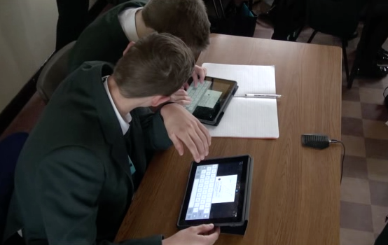
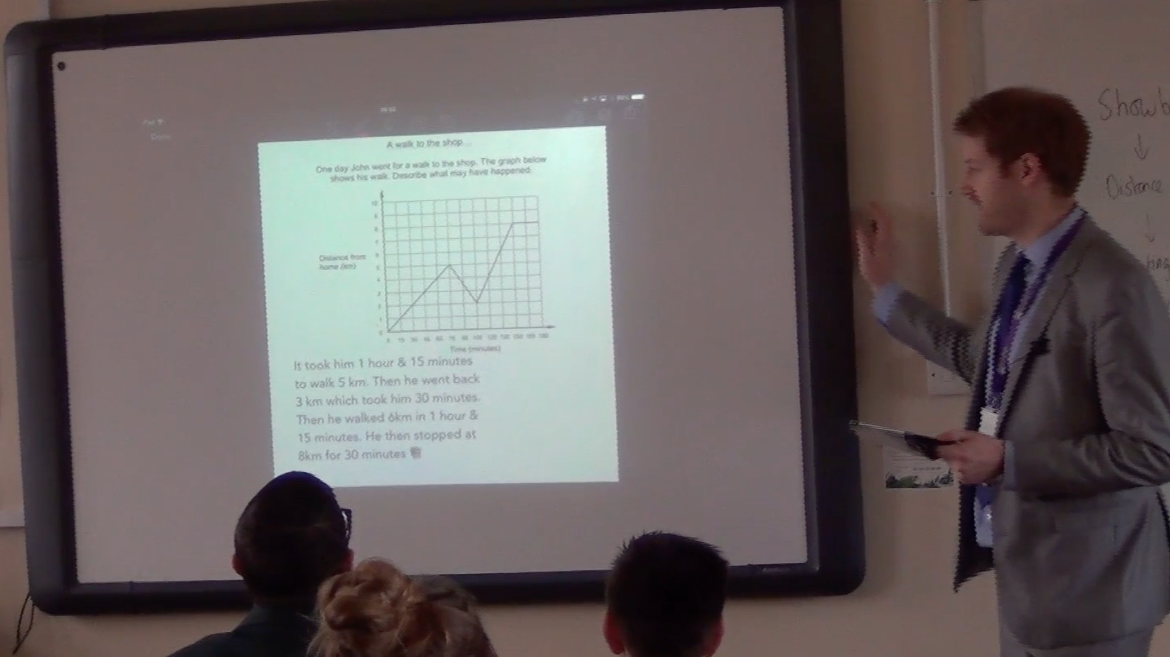
Interpreting a graph
A walk to the shop...
One day John went for a walk to the shop. The graph shows his walk. Describe what may have happened.

Slide 15
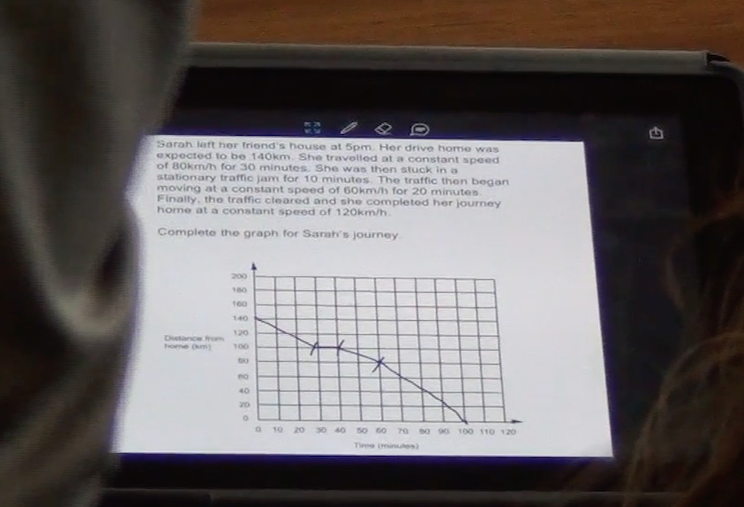
Drawing a graph

Slide 16
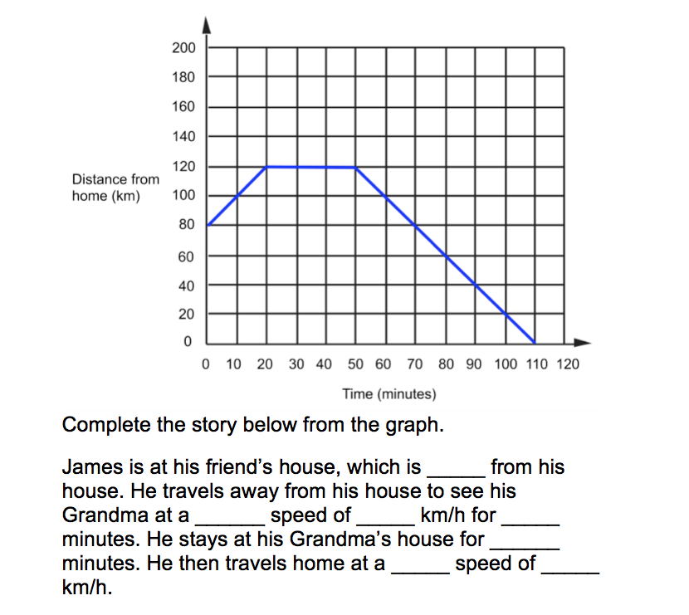
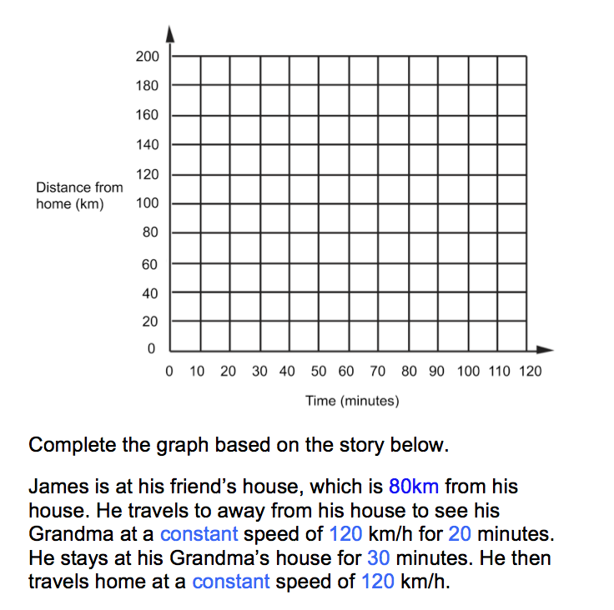
Mirrored questions
Set A
Set B

Slide 17
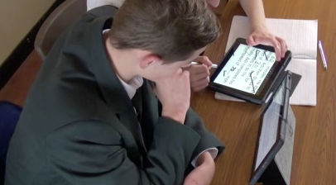
Peer assessment and discussion

Slide 18
Lesson 2: algebraic expressions
Diagnostic assessment prior to lesson using questions selected or designed by the teacher and diagnosticquestions.com;
Lesson plan adapted in response to the profile of student responses and the reasons given;
Use of Nearpod in class to send, receive and display selected student responses;
Selected student work used to discuss and address misconceptions.

Slide 19
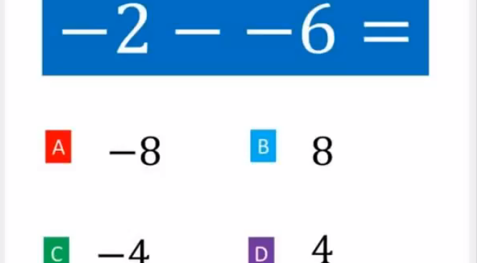
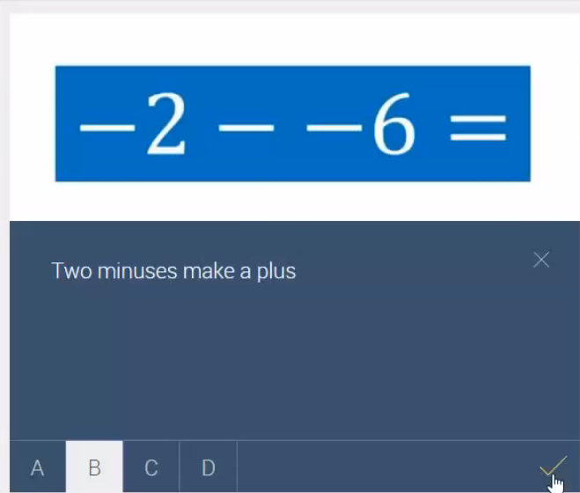
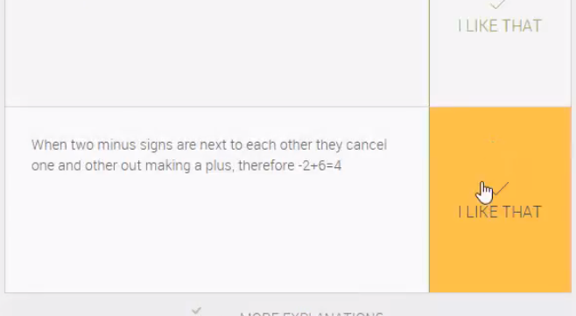
Computer assessment and student reflection

Slide 20
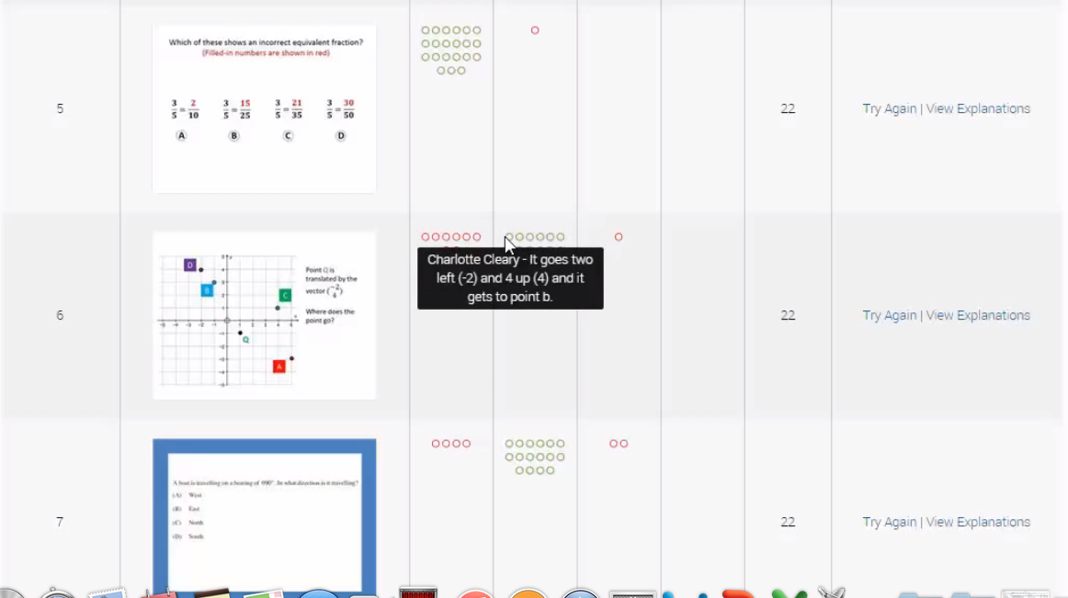
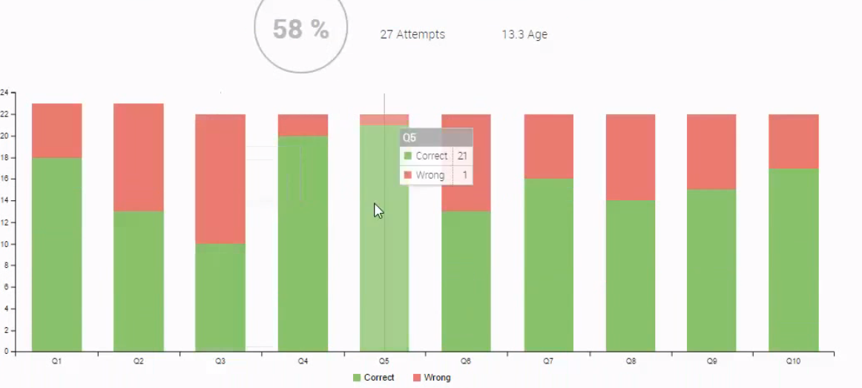
Teacher overview

Slide 21
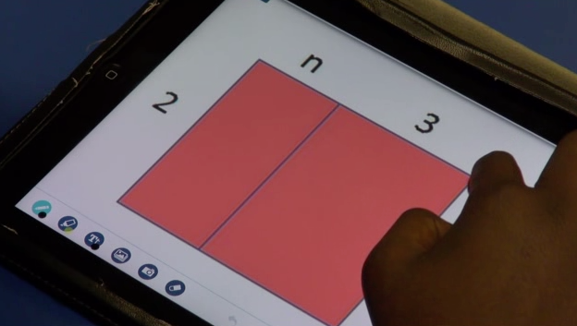
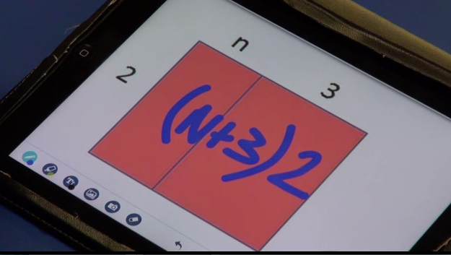
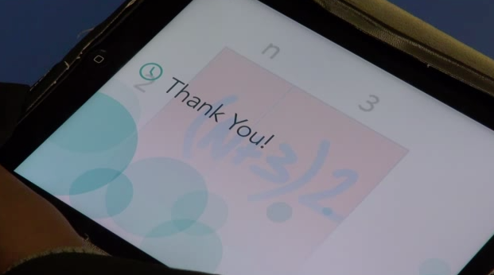
Sending questions
Receiving responses

Slide 22
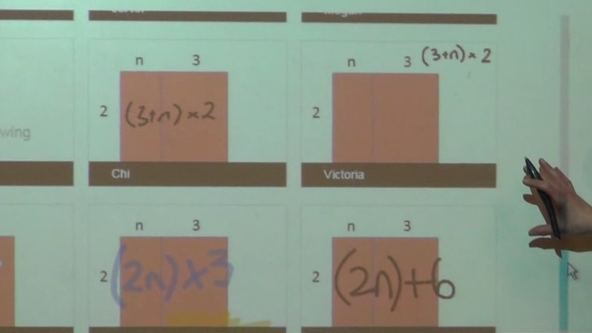
Class discussion

Slide 23
Formative assessment areas
What is the impact from using the technology when:
Building on students’ prior knowledge;
Identifying and responding to students’ conceptual difficulties;
Using questioning;
Increasing student collaboration;
Enabling students to become assessors?

Slide 24
Examples of uses of technology in formative assessment processes
Building on students’ prior knowledge:
Pre-lesson diagnostic assessment and class overviews are used in lesson planning.
Identifying and responding to students’ conceptual difficulties:
Sample student work is selected and displayed to expose misconceptions.
Using questioning:
Student work is displayed and students are questioned about their methods.
Increasing student collaboration:
Students compare and discuss their work even when working on individual iPads.
Enabling students to become assessors:
Peer assessment takes place during class discussion and collaborative work.

Slide 25
Before a lesson
Summary of use | Examples of apps, systems. | Process | Assessment and response | Comparison to paper-based process
Closed response questions are sent to students to complete and return to the teacher. These may or may not be processed into summaries by the system. | For communication: Nearpod Showbie + for question design: Socrative Mathspace | Teacher gains an overview of students’ facility with the content prior to lesson. | Teacher gains some information on student understanding to use in planning the lesson. Teacher may group students according to results, for example, so that one can help another. | Advantages: Replacement with benefit of easy access for the teacher. Summary information has benefit of the speed at which this is available to the teacher and time saved for teacher. Drawbacks: Limited number of question formats available on some software.

Slide 26
Within a lesson (summary data)
Summary of use | Examples of apps, systems. | Process | Assessment and response | Comparison to paper-based process
Questions are sent to students electronically during the lesson and responses returned to teacher. These are processed by the system into a summary form. They may or may not be displayed (e.g. as progress bars) on the IWB. | Nearpod Showbie Socrative Mathspace | Teacher gains overview of student responses. Students gain overview of student responses. | Teacher gains information of the progress of the class at intervals during the lesson and can adjust the lesson plan to address common misconceptions. If displayed on IWB, students can evaluate their own progress compared with others in the class. | Advantages: Replacement with benefit of speed of obtaining data and easy access for teacher. Drawbacks: If displayed on IWB, students can become more concerned with competition with peers than with mathematics.

Slide 27
Within a lesson (student reasoning)
Summary of use | Examples of apps, systems. | Process | Assessment and response | Comparison to paper-based process
Questions are sent to students electronically during the lesson to complete and return to teacher. Student working and reasoning is made visible to the teacher. Student reasoning may be shared with class on IWB. | Nearpod Showbie Mathspace | Teacher gains information about individual student progress, working and understanding. Provides sample student work that may be displayed and discussed with the whole class. | Teacher gains information about the progress of individual students at intervals during the lesson and can adjust the lesson plan to address common misconceptions. Teacher identifies common misconceptions from student work and addresses these using appropriate samples of student work and questions for class discussion. Students view alternative solutions, assess samples of work from their peers and compare these with their own solutions to develop understanding. | Advantages: Replacement with benefit of speed of obtaining data and easy access for teacher. Students can engage with and discuss each other’s reasoning during the lesson. Drawbacks: Often software projects work that is physically too small and unclear. Room needs correct lighting.

Slide 28
Uses of technology in formative assessment
Sending and displaying;
Processing and analysing;
Providing an interactive environment.

Slide 29
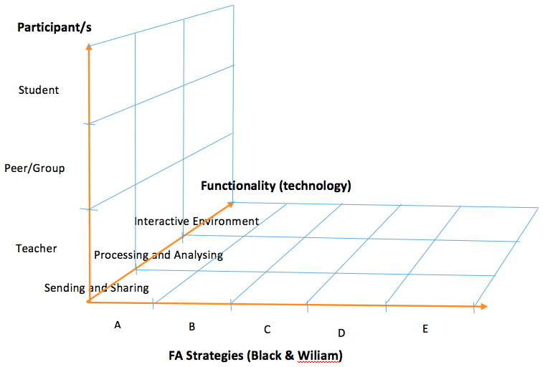
Fasmed framework

Slide 31
EXAMPLE 1
The teacher sends a question to the students electronically – the students work individually to work out solutions on their iPads and record their methods – the students then compare and discuss solutions with each other in groups – individual students receive feedback on their solutions from their peers – individual students interpret the feedback, adjust their thinking and produce improved solutions.
(The technology only performs a ‘Send and display’ function)

Slide 32
EXAMPLE 2
The teacher sends a question to the students electronically – the students work individually, record their solutions, with their working, on their iPads and send these electronically to the teacher – the teacher displays a sample student response and asks the class to comment on the solution - the students provide feedback on the sample student response. The teacher may also provide feedback. The student interprets this and is challenged to rethink their solution.
(The technology only performs a ‘Send and display’ function)

Slide 33
EXAMPLE 3
Multiple-choice questions are written by the teacher and sent electronically to the students prior to the lesson – the students send their responses back electronically – the computer marks the student work and processes the class set of responses – the computer provides feedback to the teacher in the form of a visual summary of the correct and incorrect responses to each question for the whole class (e.g. bar chart) – the teacher interprets this information and adjusts their lesson plan to focus on the areas of conceptual understanding that are highlighted as requiring development.
(The technology performs a ‘Send and display’ and a “Process and analyse’ function)

Slide 34
EXAMPLE 4
The technology generates a series of questions that have not been directly selected or written by the teacher - students respond individually - students record their responses on the computer - the technology processes each response and sends back a cumulative summary to the teacher that they can access at time to gain an overview of progress at that instant. The technology also provides feedback to the student on each question as they complete it and adapts the next question, making it easier or harder depending on the response elicited. This cycle is repeated. For students in difficulty, the teacher intervenes and gives additional feedback to the student.

Slide 35
Summary
The speed and accessibility of information provided electronically is beneficial;
The effective use of information provided by digital technology in formative assessment is dependent on appropriate teacher action;
Pedagogy is important. Teachers need to understand how to interpret and use information;
Detailed analysis of the process highlights key decision points for teachers;
Using formative assessment processes as a means of examining the impact on learning of digital technology focusses the study on areas where positive effects can be expected.

Slide 36
Thank you!
diane.dalby@nottingham.ac.uk

